Slide 1
Stellar Classification
Cho, HyunMin
Data Science Term Project
Team 8
202035390 ChoHyunMin
201735860 LeeSeungCheol
201935097 LeeSeoHyun
201837337 ParkChaeLim

Slide 2
CONTENTS
1. Dataset
2. Data
Preprocessing
3. Algorithm
&Evaluation
6. Conclusion
5. Best Combination
4. Ensemble
Learning

Slide 3
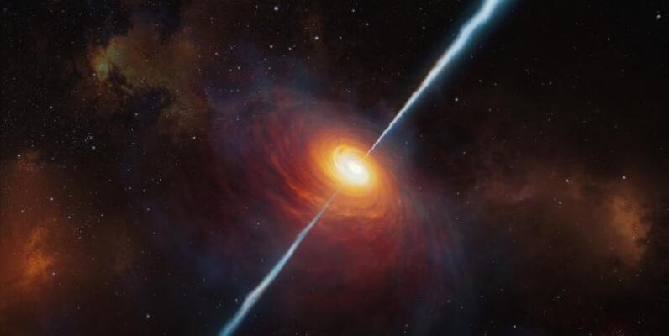
Abstract
In astronomy, the classification of stars is the classification of stars according to their spectral properties. (Kaggle, 2017)
The early classification and distribution of stars in the sky made up our galaxy.
As andromeda was a separate galaxy from our own, more powerful telescopes were created, and numerous galaxies began to be investigated. (Kaggle, 2017)

Slide 4
Dataset
Objective
Classify stellar values
with higher accuracy
Find accurate method
to classify stellar values

Slide 5
Dataset
spec_obj_ID
Dataset Row & Column (100000,18)
9. run_ID
10. rereun_ID
11. cam_col
12. field_ID
13. spec_obj_ID
Photometric
System
1. obj_ID
2. alpha
3. delta
Unique ID
4. u
5. g
6. r
7. i
8. z
14. class
Categorical
Photometric
System
15. Redshift
16. Plate
17. MJD
18. fiber_ID
Unique ID
Notes:
obj_ID = (Object Identifier) the unique value that identifies the object in the image catalog used by the CAS
alpha = Angle of ascension (RA - Celestial coordinates).
delta = angle of declination (DEC - Celestial coordinates)
u = Ultraviolet filter in the photometric system
g = Green filter in the photometric system
r = Red filter in the photometric system
i = Near-infrared filter in the photometric system
z = Infrared filter in the photometric system.
run_ID = run ID used to identify the specific scan
rerun_ID = Specifies the type of image processing.
cam_col = Identifies a specific scan line belonging to a single run
field_ID = Identifies the portion of the sky observed in a run.
spec_obj_ID = Unique ID used to identify each scan in the dataset.
class = Target variable: Galaxy, Star, Quasar.
redshift = Batochrome effect, based on the increase in the wavelength of the spectrum light detected
plate = ID identifying the spectograph used
MJD = Date of detection
fiber_ID = Identifies the optical fiber used on the spectograph of each observation

Slide 6
Data Preprocessing
Sequence
1. Encoding
a. Null Value Detection
b. Outlier Detection
2. Dirty Data Processing
a. Correlation Matrix
b. Analyze Feature using graph
3. Feature Selection
a. Standard Scaler
b. MinMax Scaler
c. Robust Scaler
4. Scaling / Normalization

Slide 7
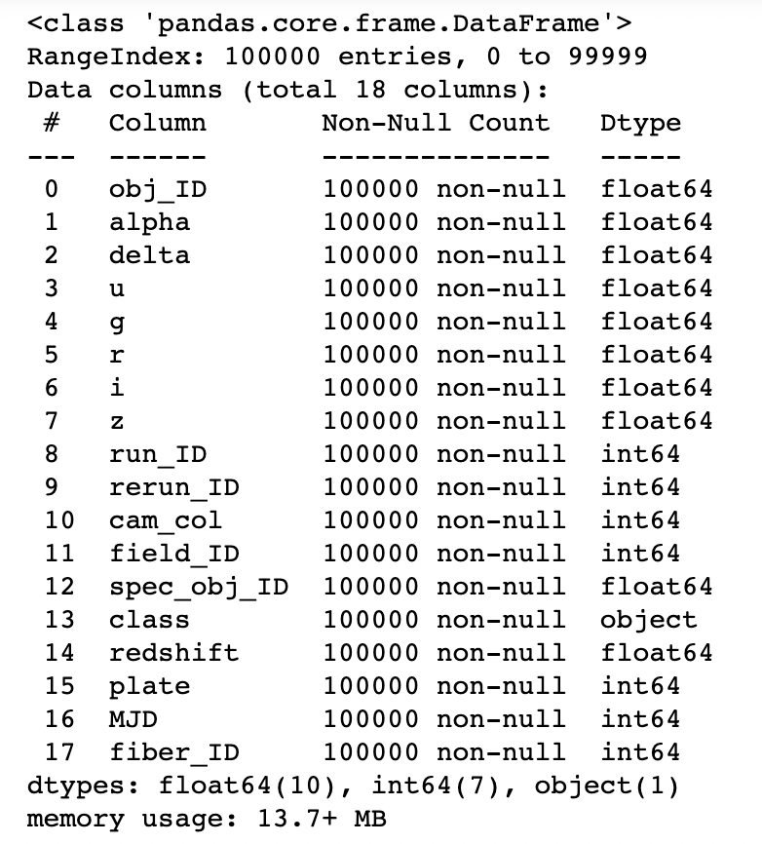
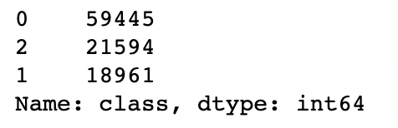
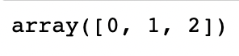
Data Preprocessing
1. Encoding
1- a. Check Data Type
1-b. Check Unique value of Object Data
1-c. Encoding
GALAXY | QSO | STAR
0 | 1 | 2

Slide 8
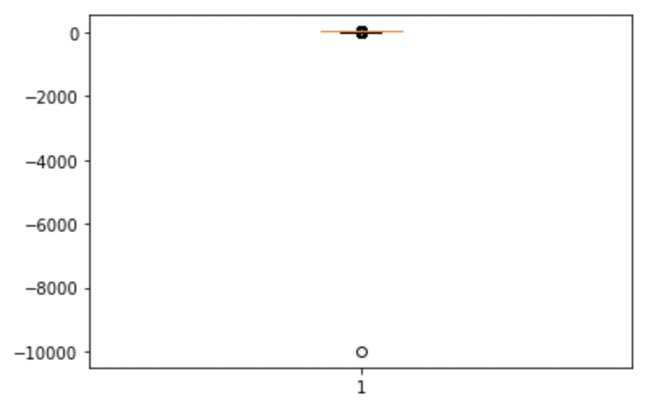
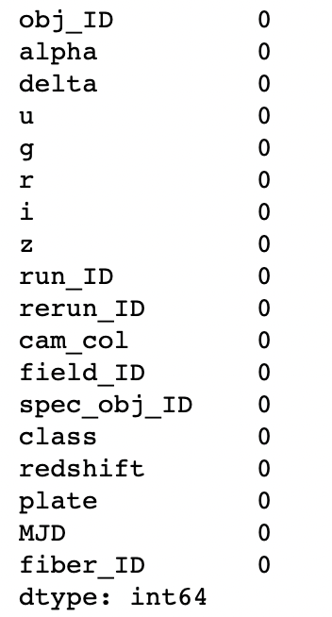
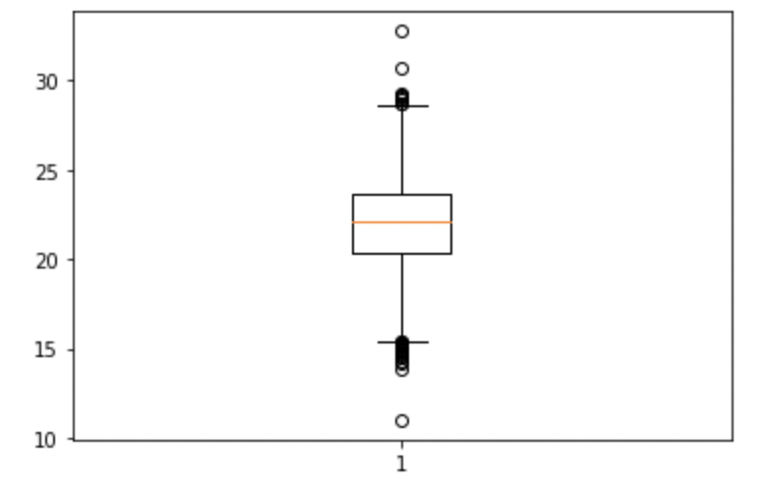
Data Preprocessing
After Remove
Outlier
2. Dirty Data Processing
2-a. Null Value Detection
2-b. Outlier Detection
Before Remove
Outlier
After Remove
Outlier

Slide 9
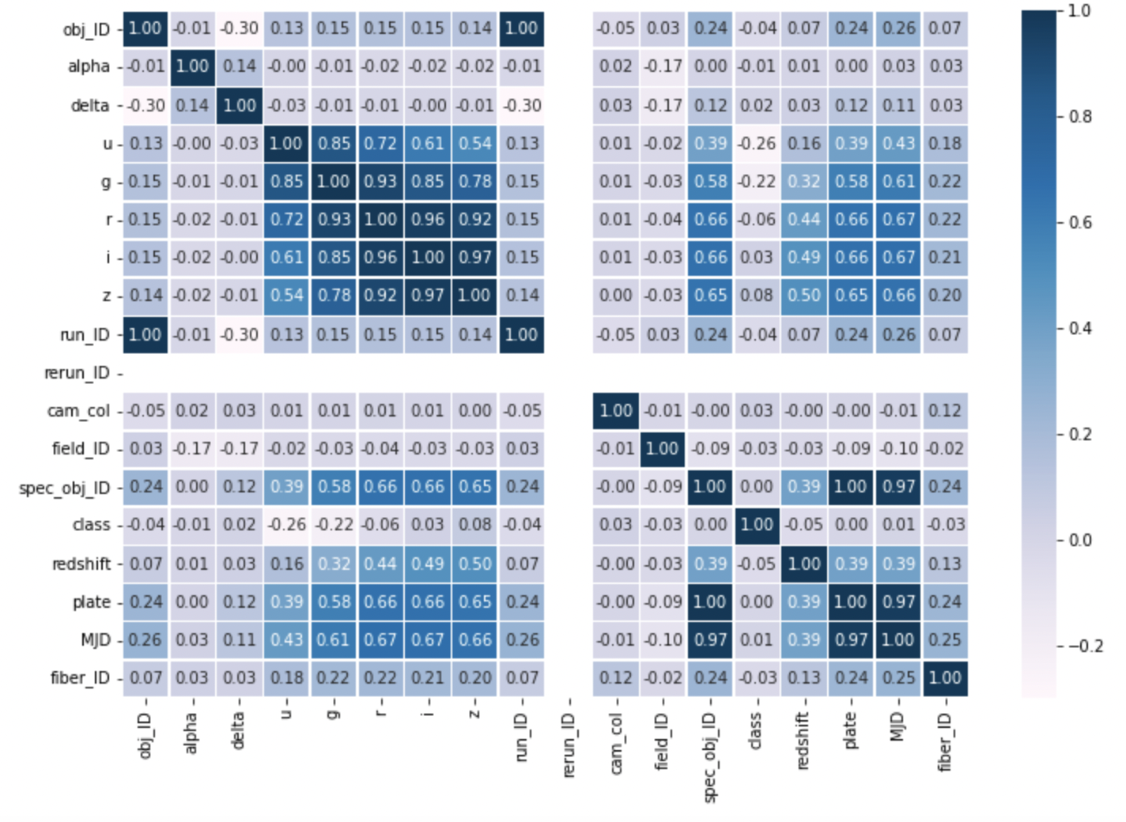
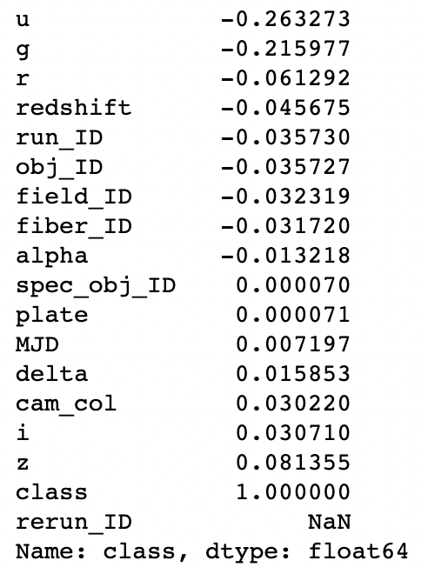
Data Preprocessing
After Remove
Outlier
3. Feature Selection
3-a. Correlation Using
Heatmap

Slide 10
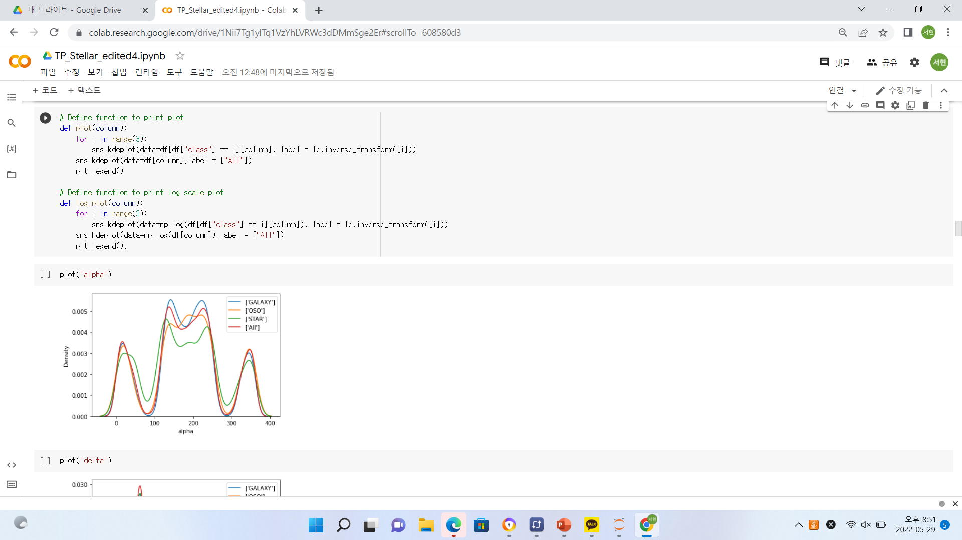
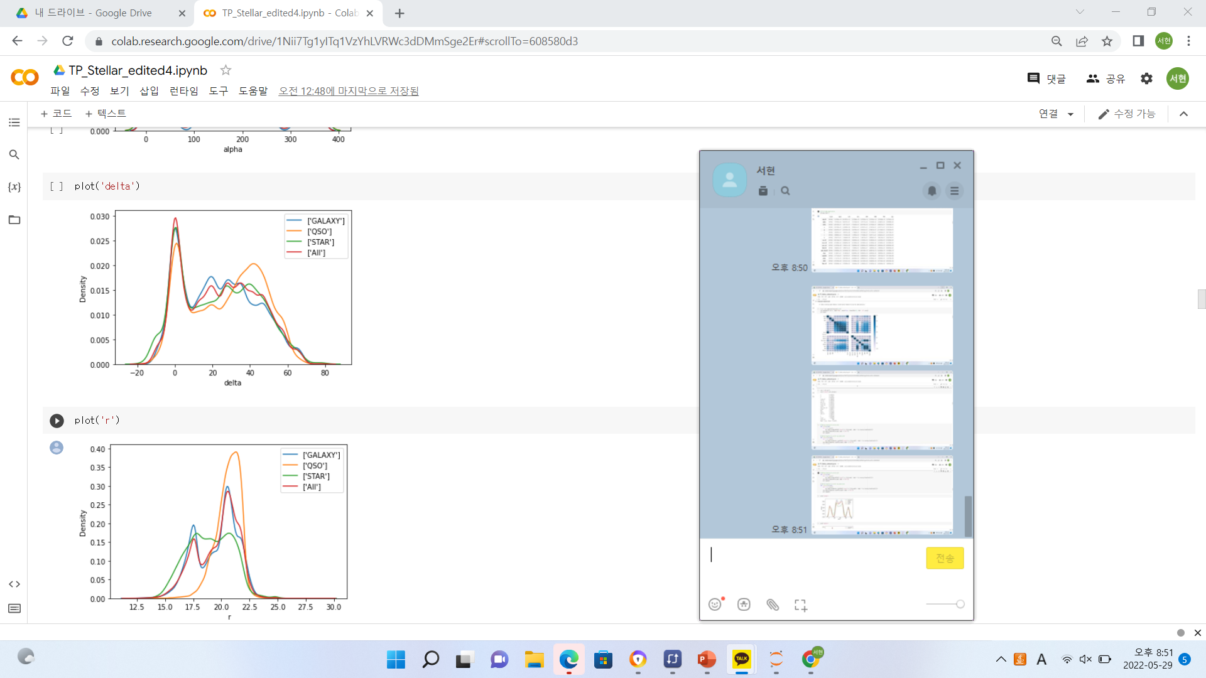
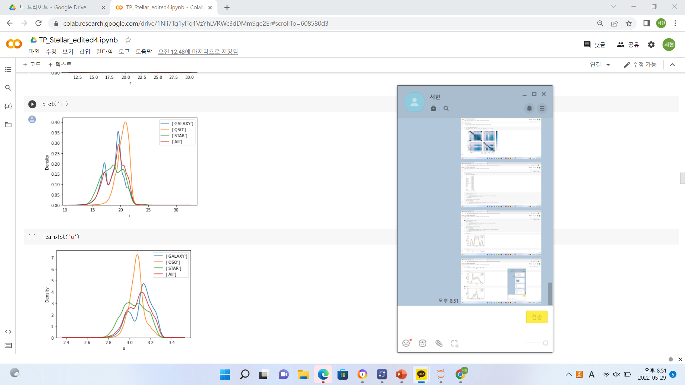
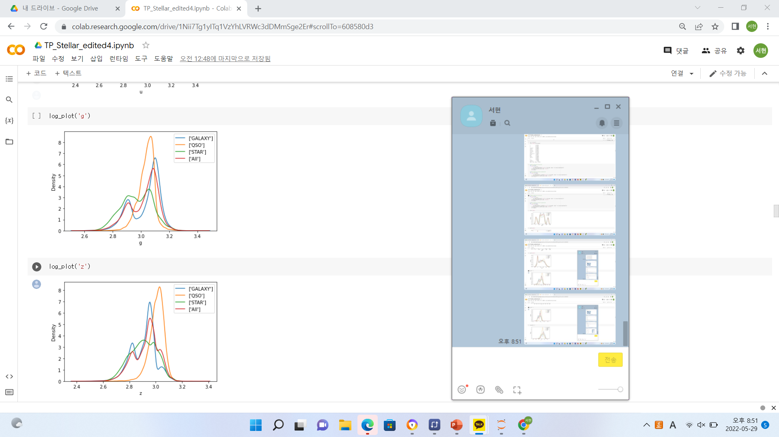
Data Preprocessing
After Remove
Outlier
3. Feature Selection
3-b. Analyze Features Using Graph

Slide 11
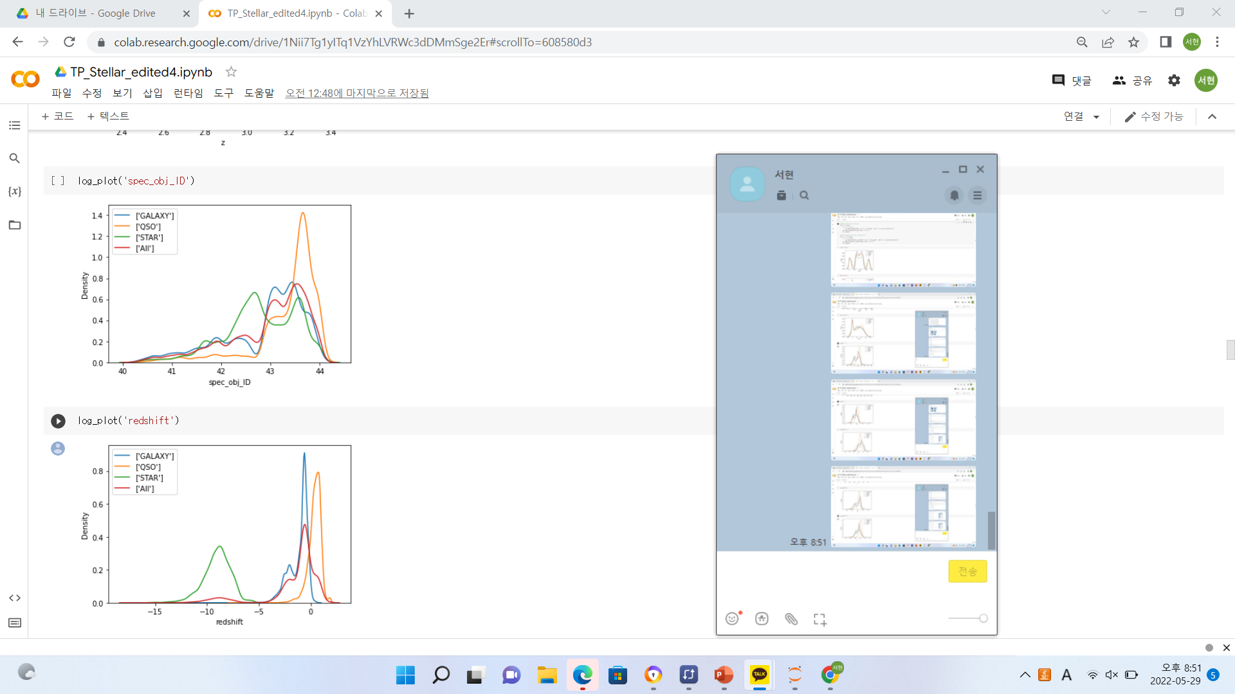
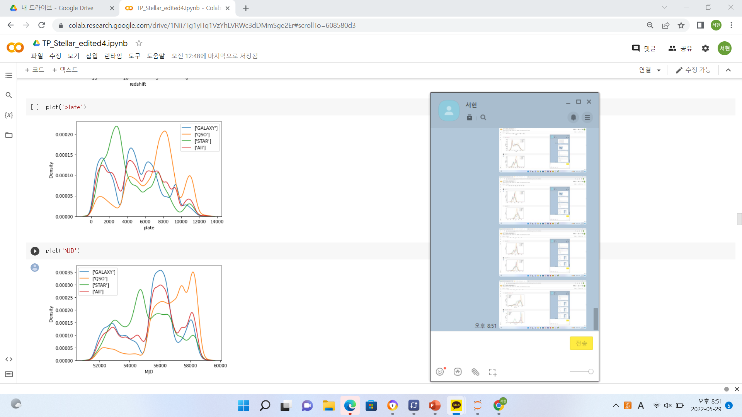
Data Preprocessing
After Remove
Outlier
3. Feature Selection
3-b. Analyze Features Using Graph

Slide 12
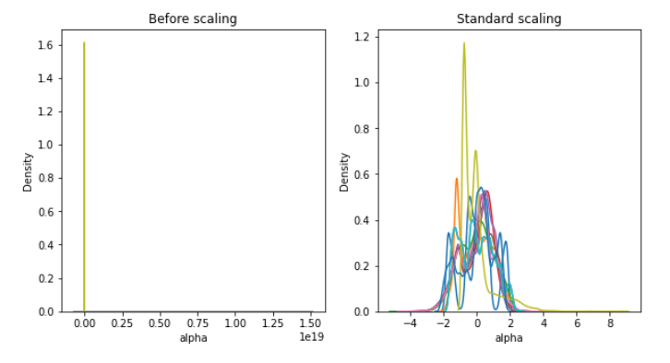
Data Preprocessing
After Remove
Outlier
4. Data Scailng / Normalization- Standard Scaling

Slide 13
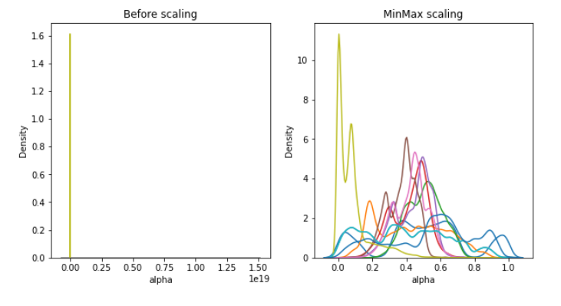
Data Preprocessing
After Remove
Outlier
4. Data Scailng / Normalization- MinMax Scaling

Slide 14
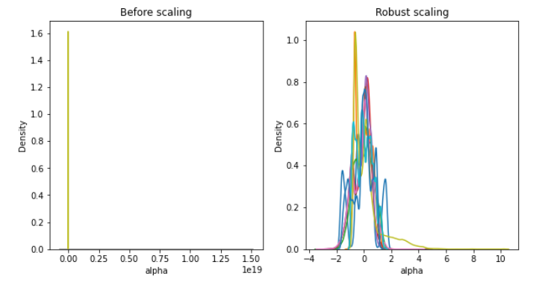
Data Preprocessing
After Remove
Outlier
4. Data Scailng / Normalization- Robust Scaling

Slide 15
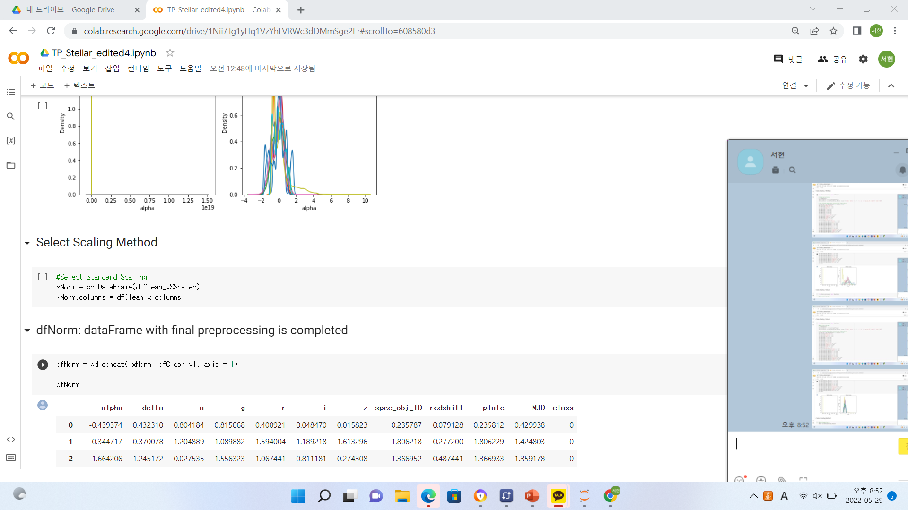
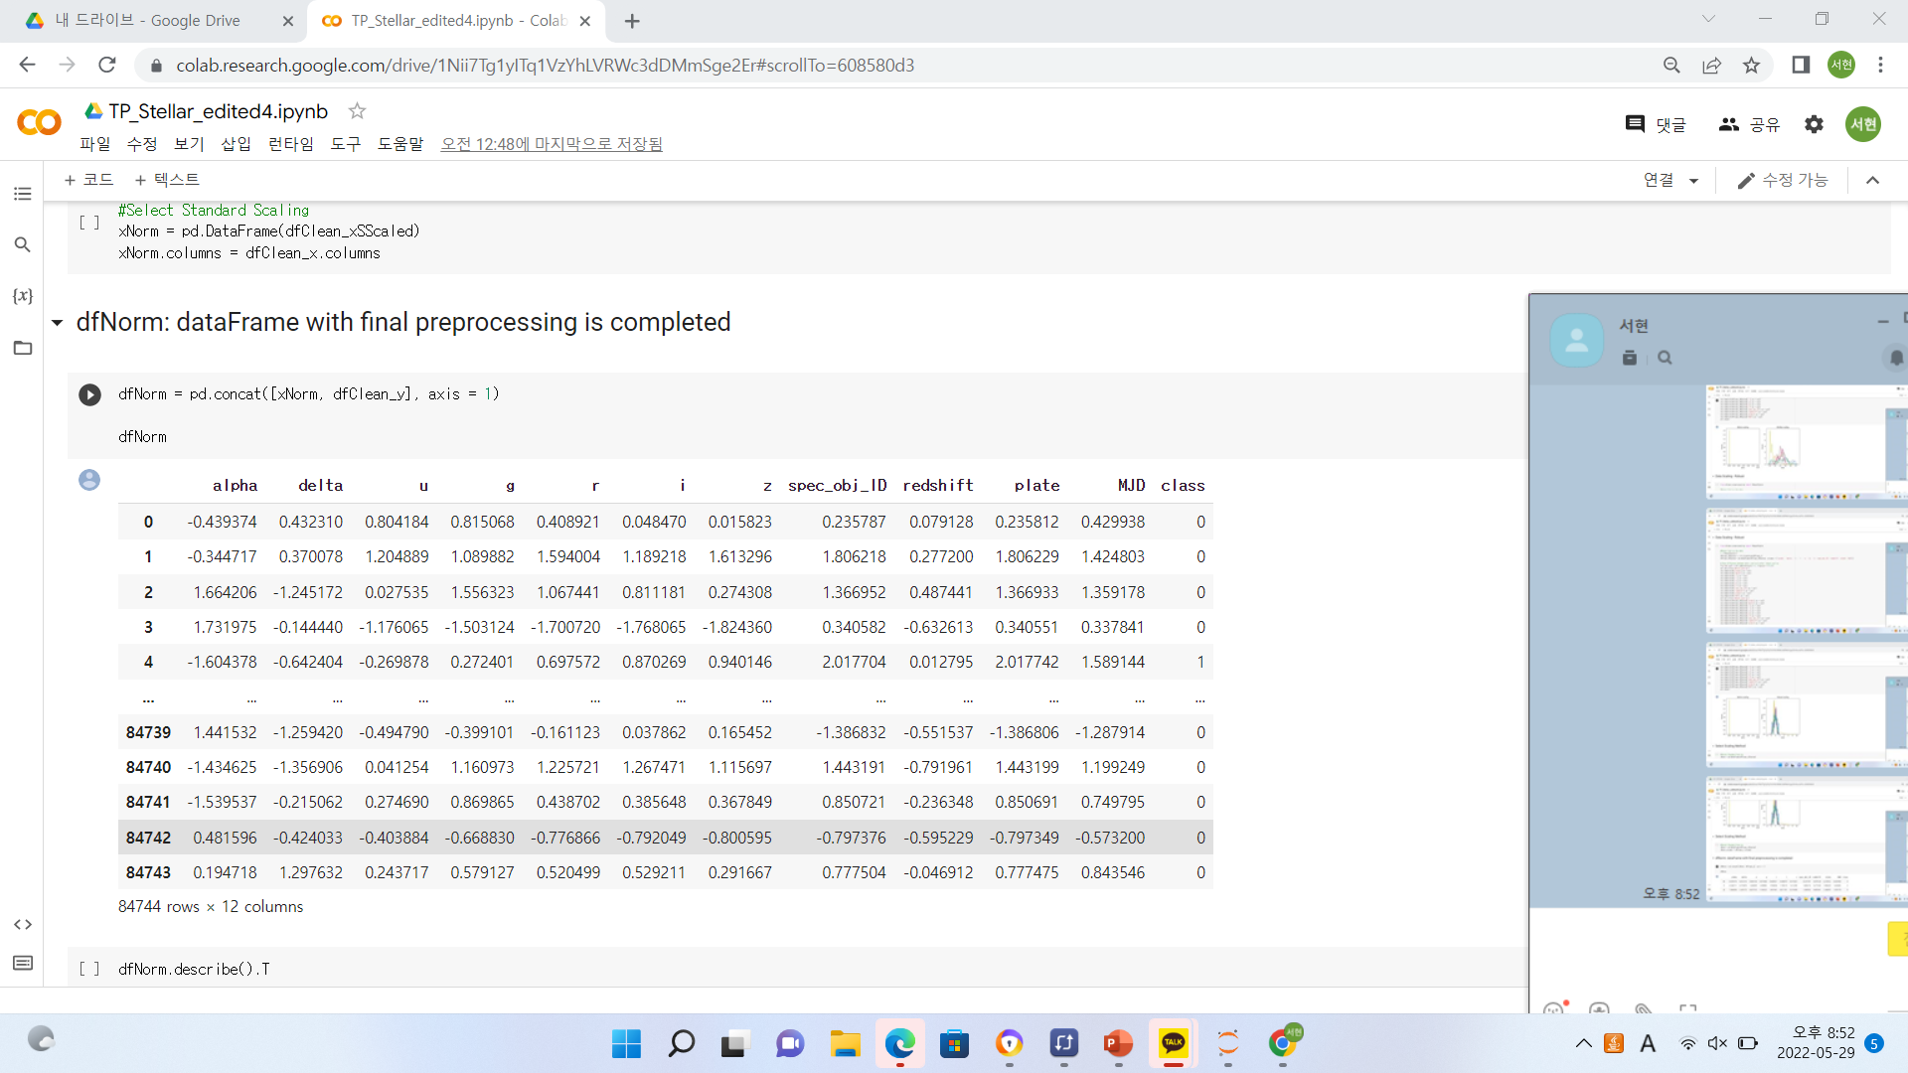
Data Preprocessing
After Remove
Outlier
4. Data Scailng / Normalization- Select Method
Select Standard Scaling
Final DataFrame
After Preprocessing

Slide 16
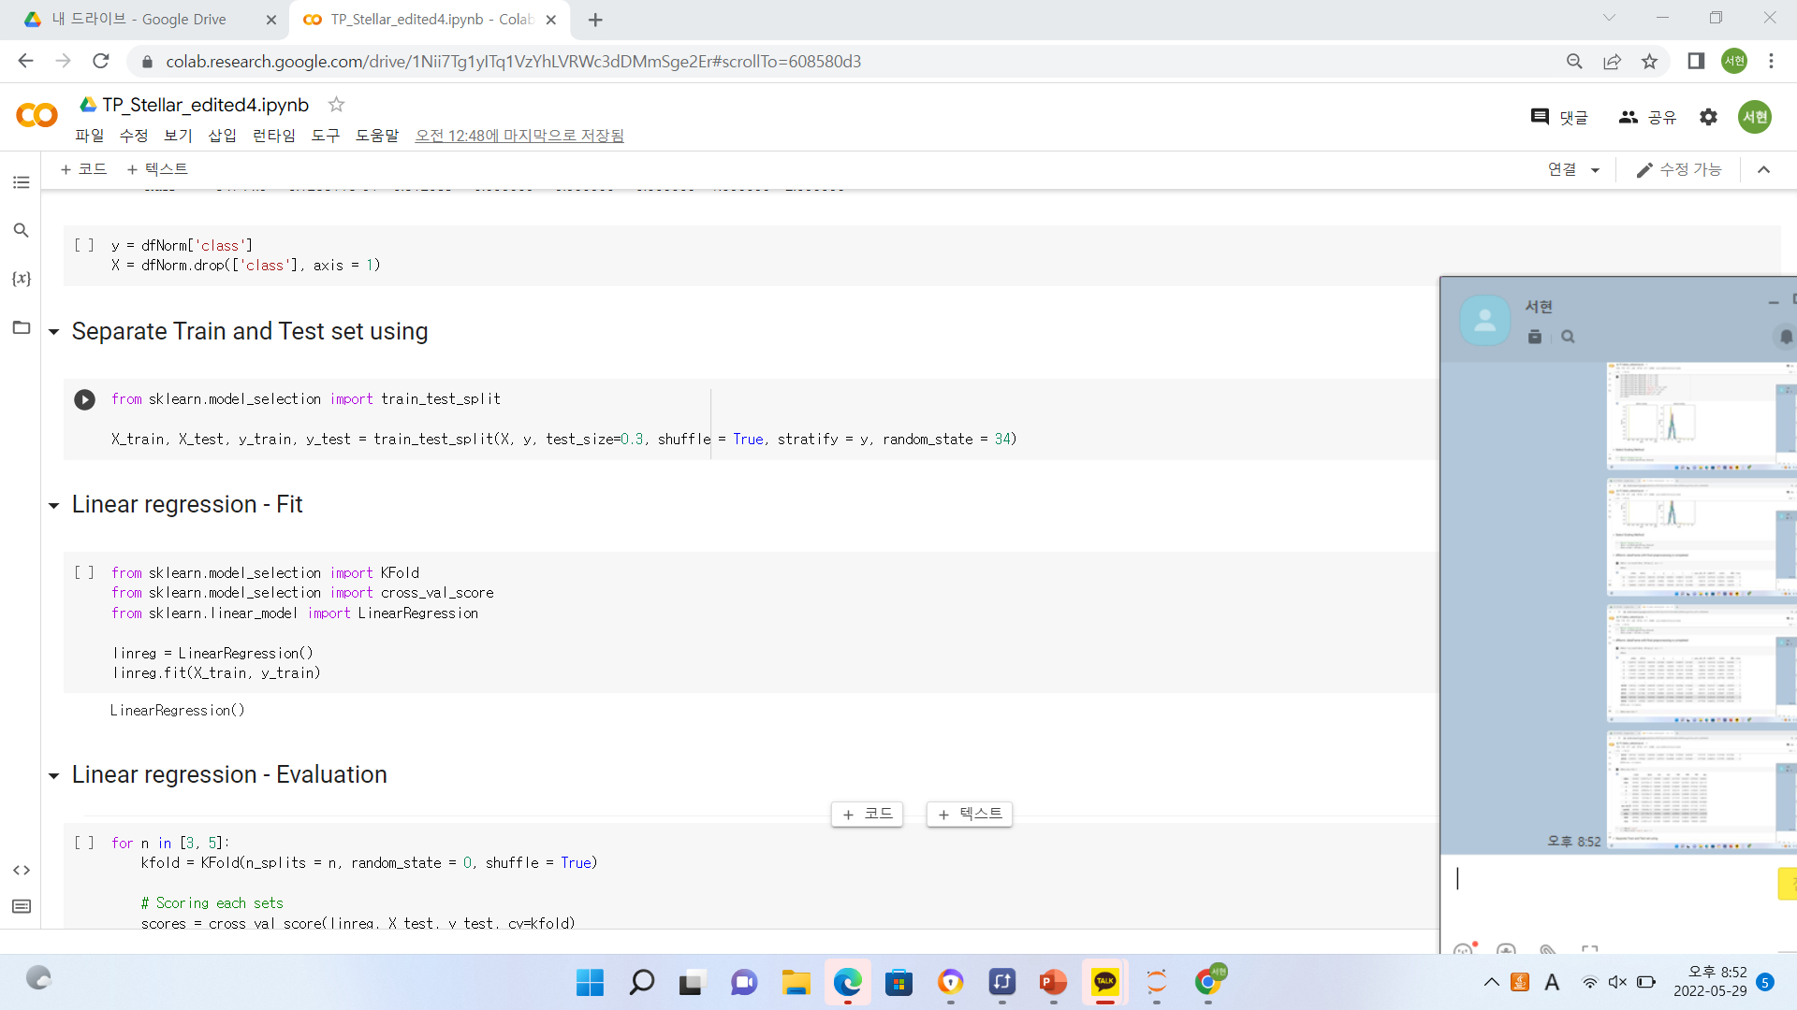
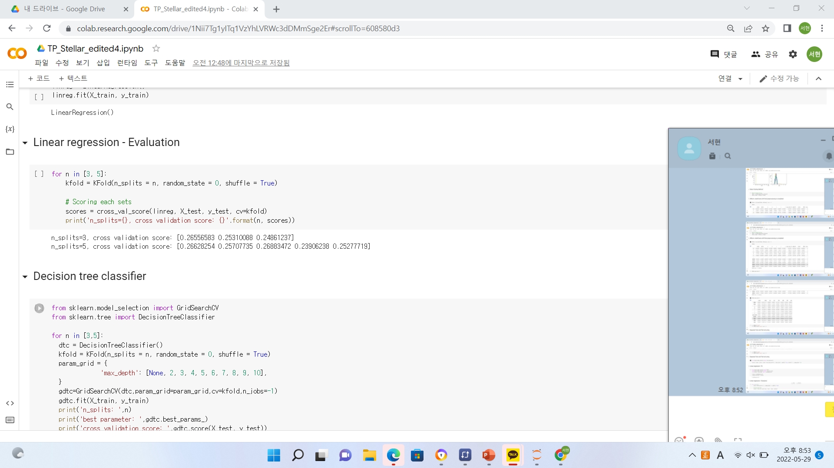
Algorithm & Evaluation
After Remove
Outlier
Linear Regression
Separate Train & Test Set
Linear Regression Output & Evaluation

Slide 17
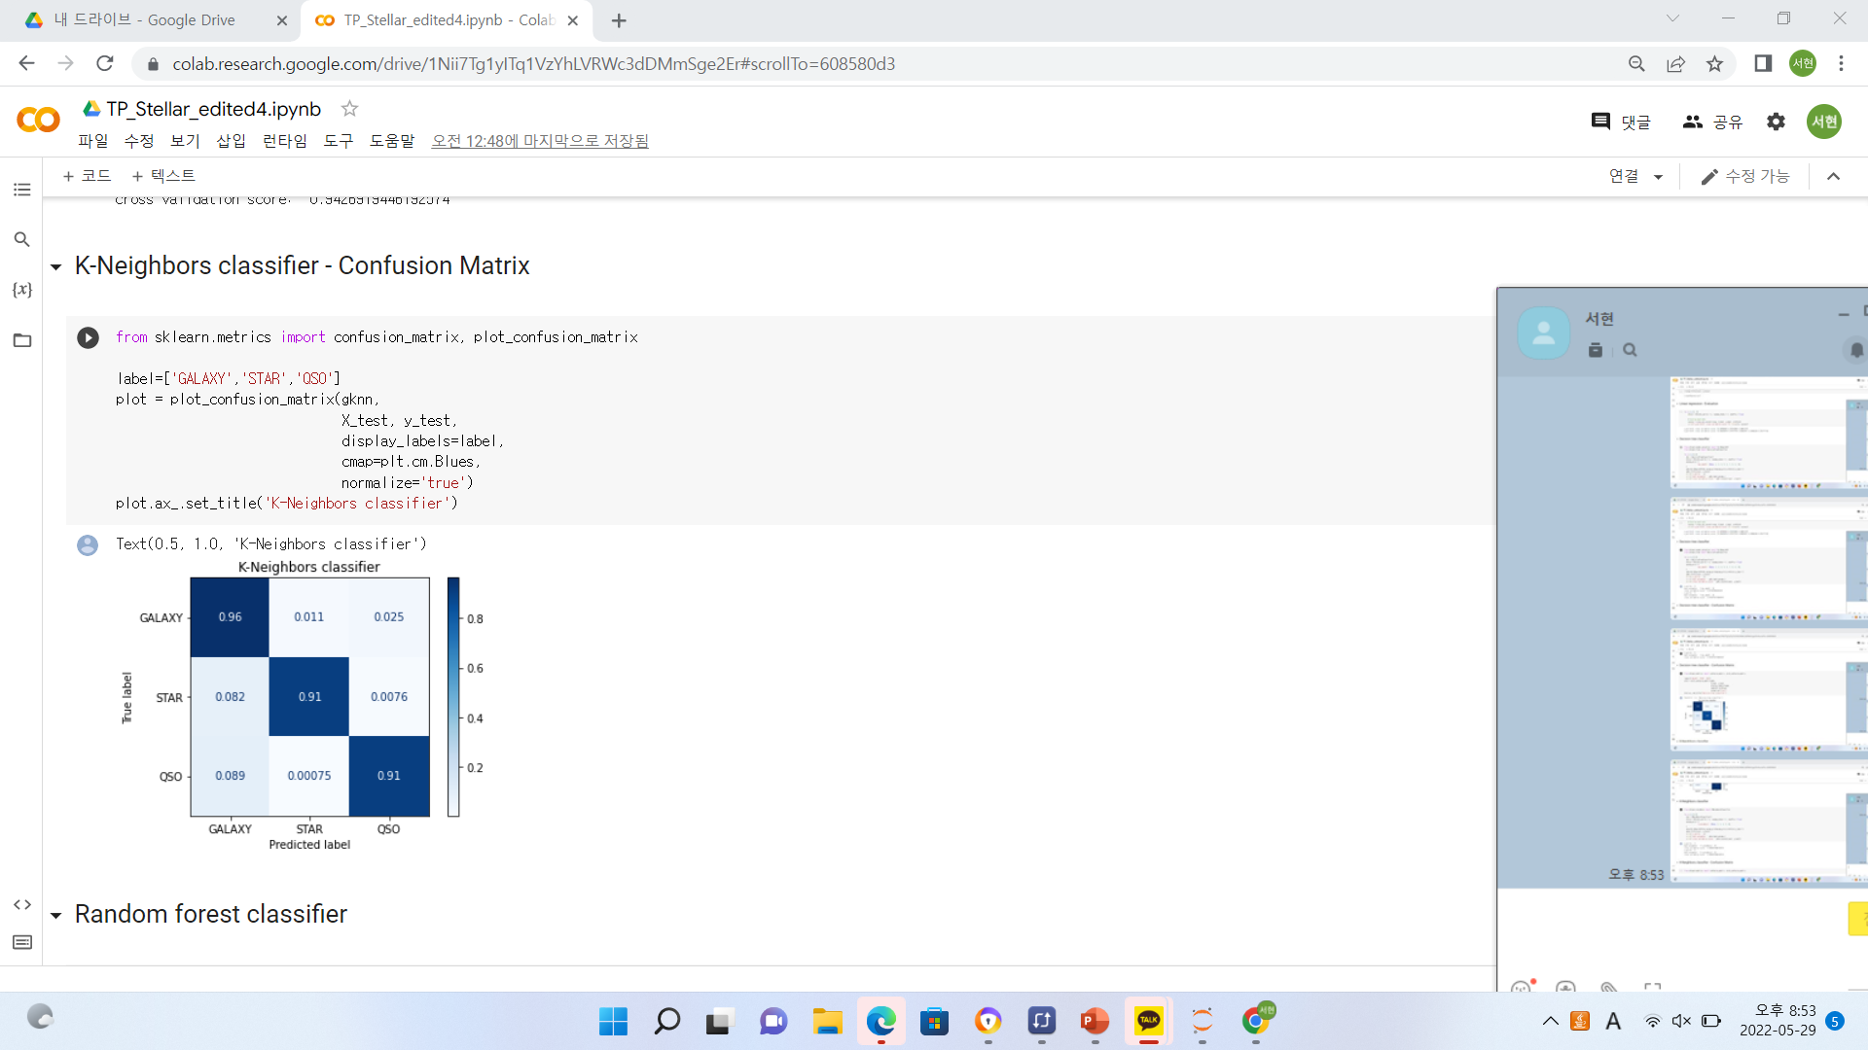
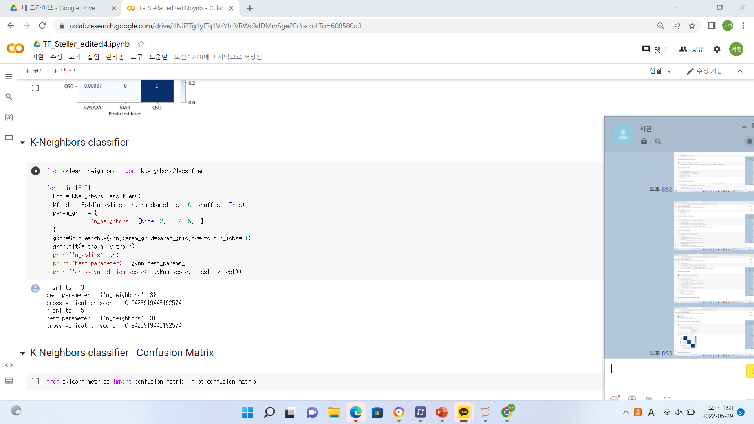
Algorithm & Evaluation
After Remove
Outlier
K-Neighbors Classifier
K-Neighbors Classifier Output
Confusion Matrix

Slide 18
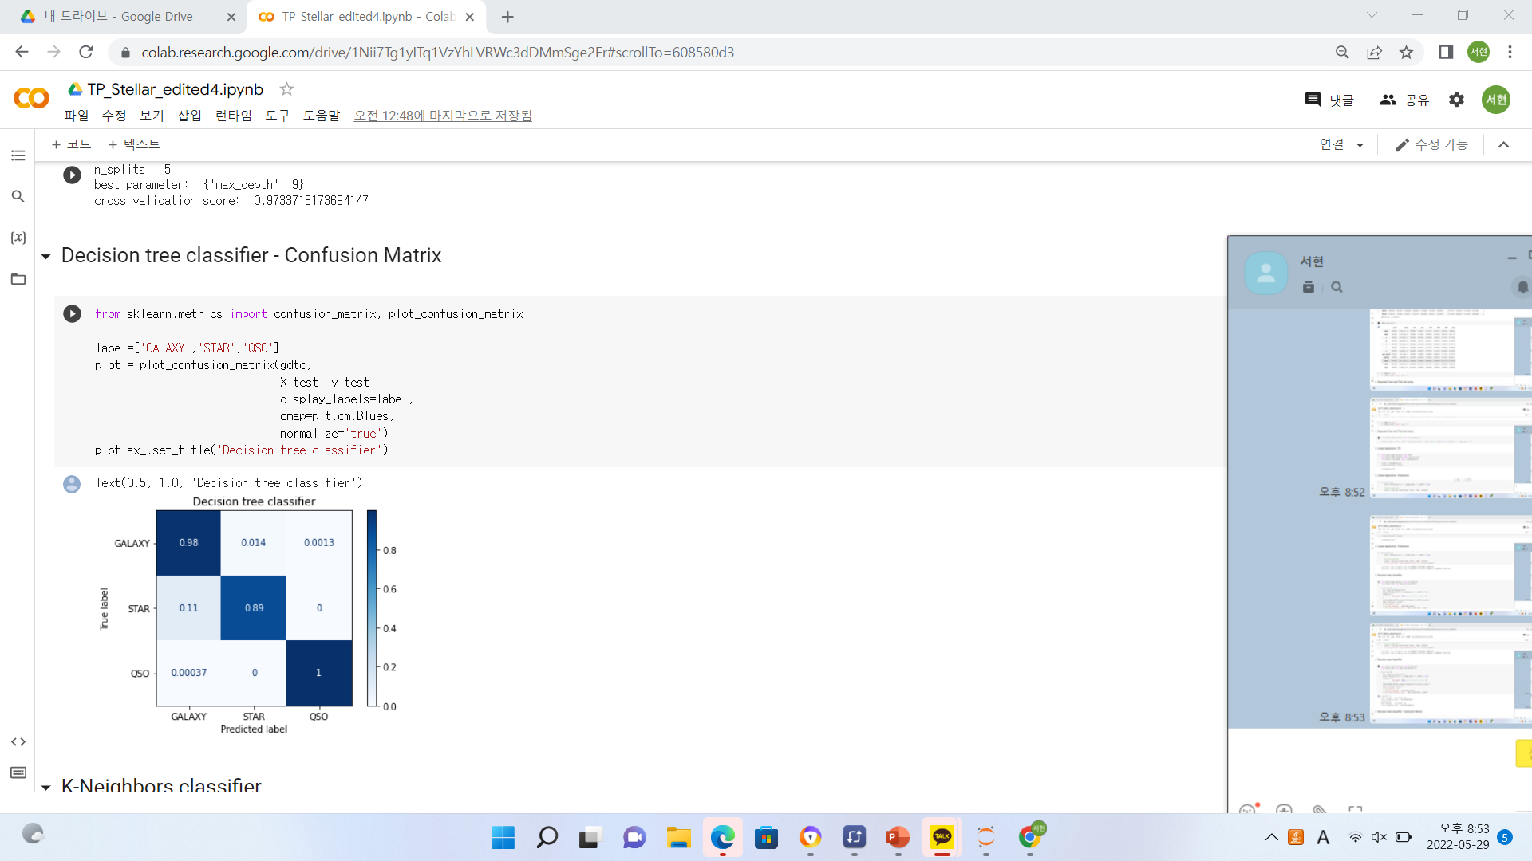
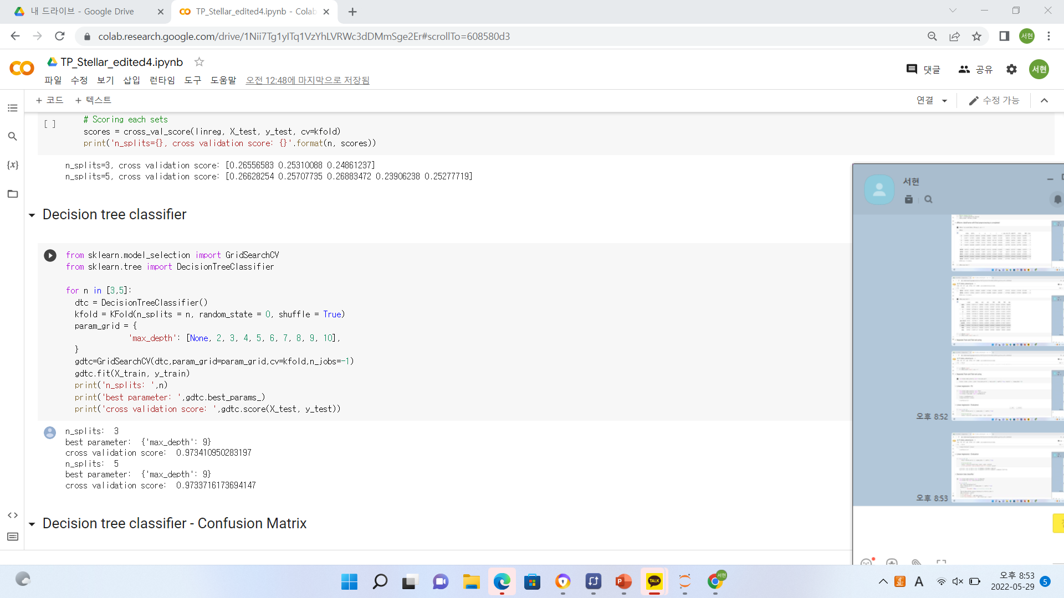
Algorithm & Evaluation
After Remove
Outlier
Decision Tree Classifier
Decision Tree Output
Confusion Matrix

Slide 19
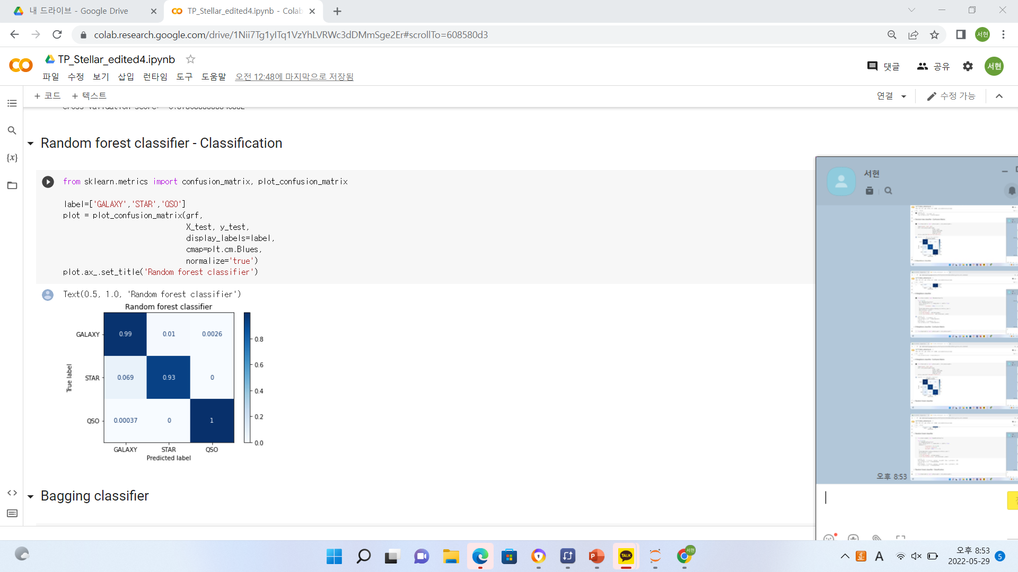
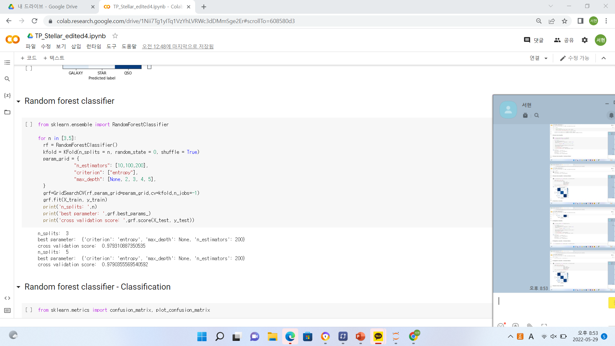
Algorithm & Evaluation
After Remove
Outlier
Random-Forest Classifier
Random-Forest Output
Confusion Matrix

Slide 20

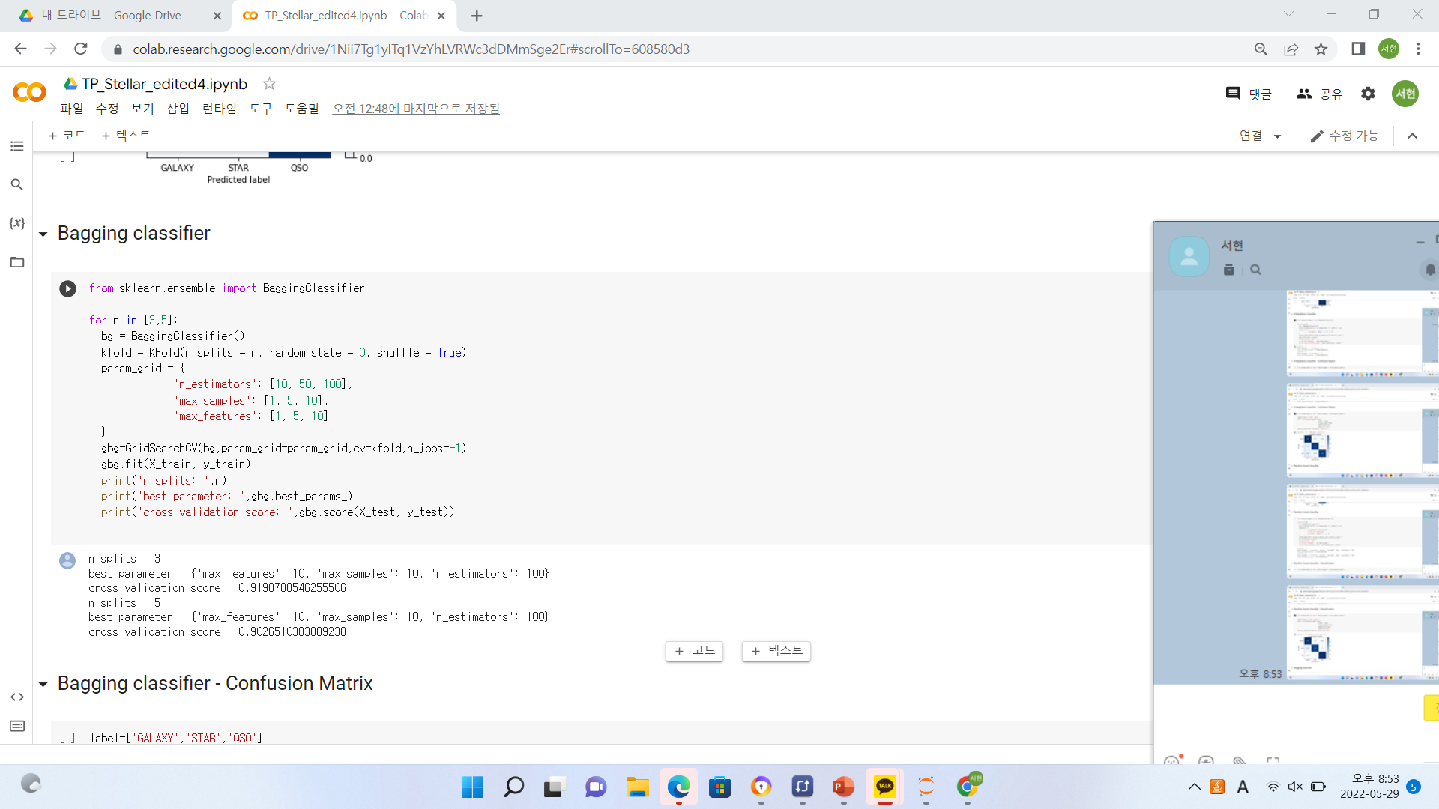
Evaluation
After Remove
Outlier
Bagging Classifier
Bagging Classifier Output
Confusion Matrix

Slide 21
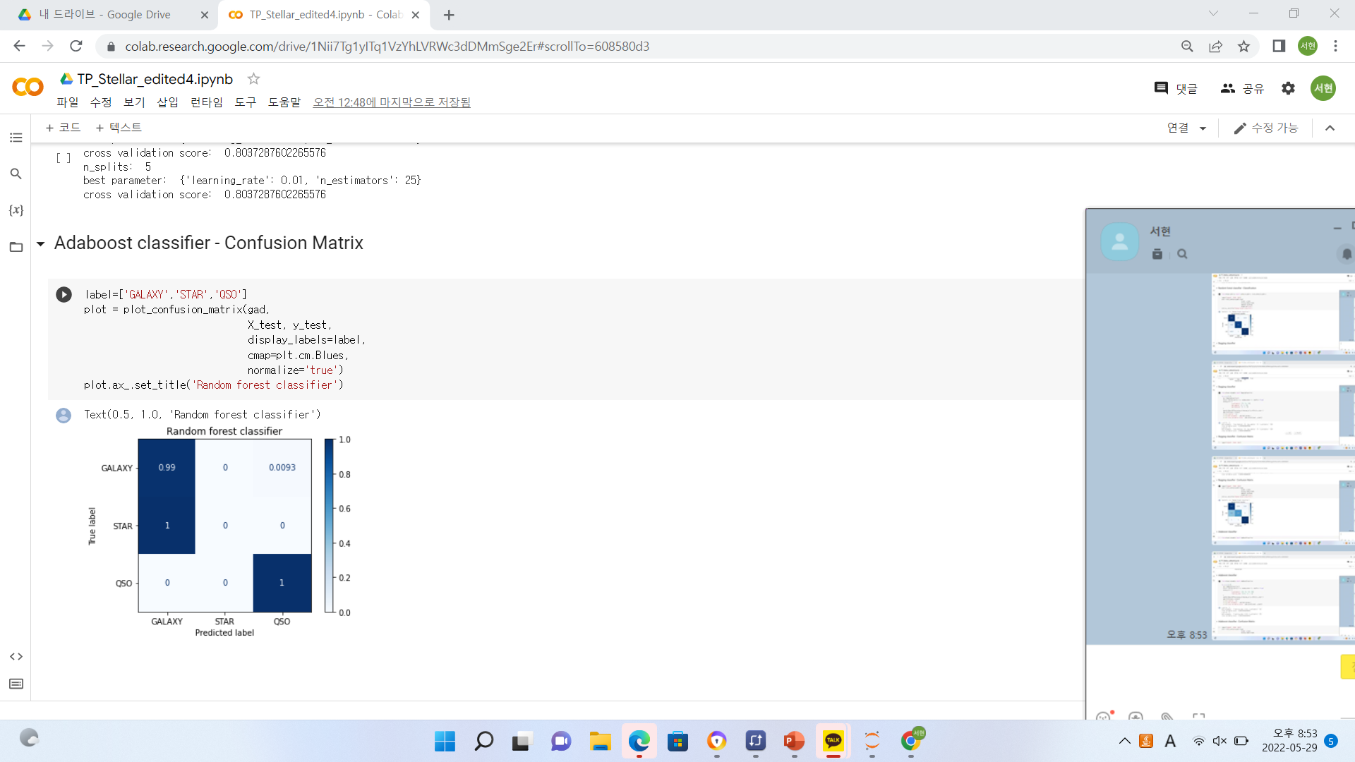

Evaluation
After Remove
Outlier
Adaboost Classifier
Adaboost Classifier Output
Confusion Matrix

Slide 22
Best Combination
After Remove
Outlier
Robust Scaling
- Random Forest
n_splits = 3 : 0.979389
n_splits = 5 : 0.979546
1
Standard Scaling
- Random Forest
n_splits = 3 : 0.979035
n_splits = 5 : 0.979153
2
MinMax Scaling
- Random Forest
n_splits = 3 : 0.977934
n_splits = 5 : 0.977580
3
Robust Scaling
- Decision Tree
n_splits = 3 : 0.973450
n_splits = 5 : 0.973646
4
Standard Scaling
- Decision Tree
n_splits = 3 : 0.973410
n_splits = 5 : 0.973214
5

Slide 23


Conclusion
After Remove
Outlier
Future work
This analysis can be used to sort out observations using inexpensive telescopes rather than expensive ones
Using the filter value to find out whether the observations are stars or not

Slide 24


Conclusion
After Remove
Outlier
Short Writeup
201935097 Lee Seohyeon
It was meaningful to apply and compare various things directly, and to be able to see what is better by conducting a term project.
201735860 Lee Seungcheol
It was meaningful to actually use various processing methods and algorithms and see that the accuracy can change depending on hyper parameters.
201837337 Park Chaelim
It was meaningful to apply various algorithms directly. It was interesting to check that the accuracy was different for each scaling.
202035390 Cho Hyunmin
As I practiced what I had learned so far, I realised how it was applied in practice.

Slide 25
Conclusion
After Remove
Outlier
Team Role
201935097
Lee Seohyeon
Data Preprocessing Final PPT
Contribution : 25%
201837337
Park Chaelim
Data Modeling
Final Presentation
Contribution : 25%
201735860
Lee Seungcheol
Data Modeling
Proposal
Contribution : 25%
202035390
Cho Hyunmin
Data Preprocessing
Final PPT
Contribution : 25%

Slide 26
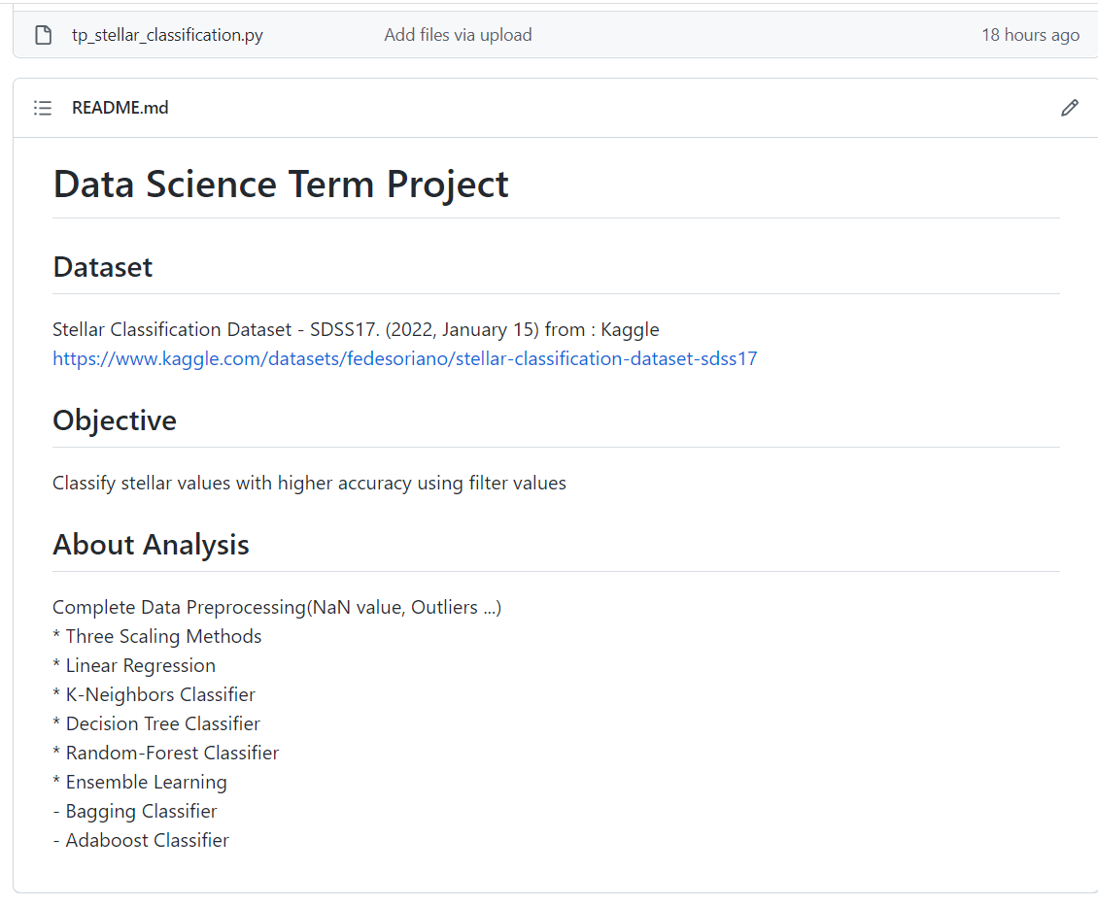
Conclusion
After Remove
Outlier
Open Source
https://github.com/Aeraekun/DSTermProject

Slide 27
References
Stellar Classification Dataset - SDSS17. (2022, January 15). Kaggle. https://www.kaggle.com/datasets/fedesoriano/stellar-classification-dataset-sdss17

